Slide 1



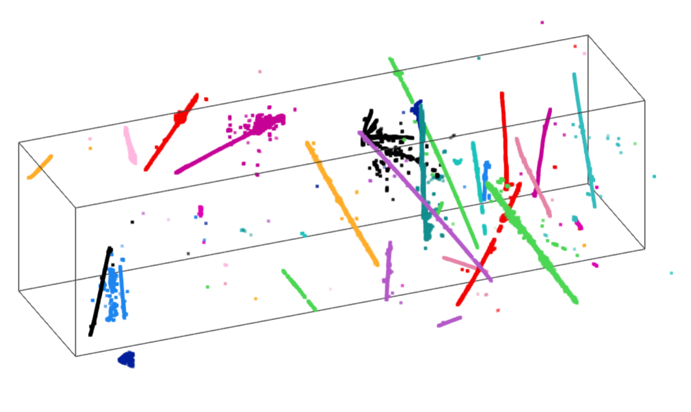
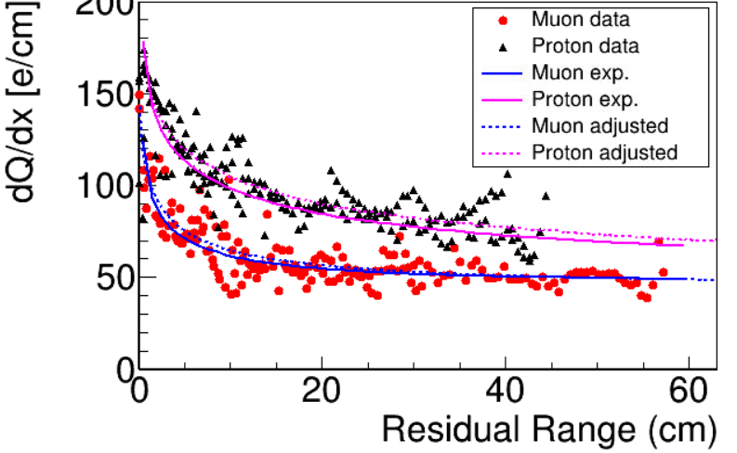
Recent Progress on Wire-Cell 3D Event Reconstruction in MicroBooNE
Wenqiang Gu
Brookhaven National Laboratory
In Progress

Slide 2
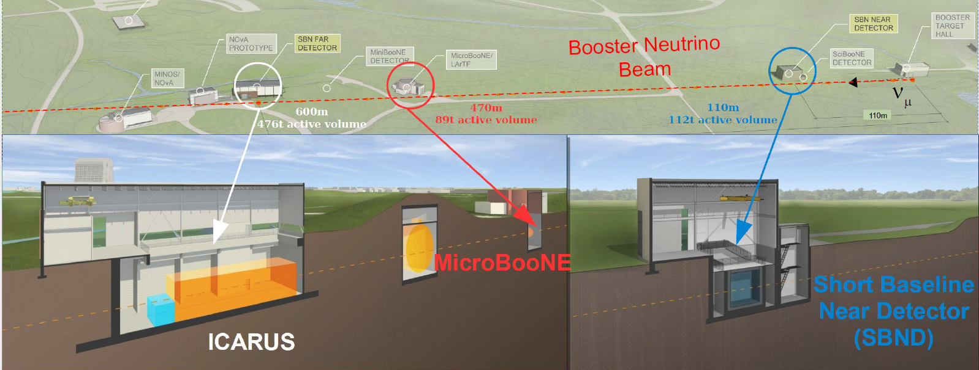
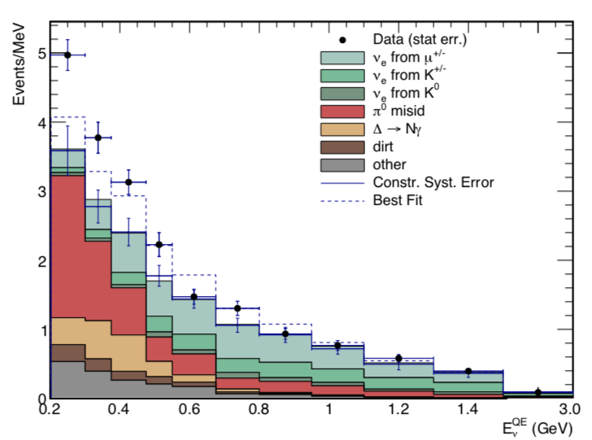

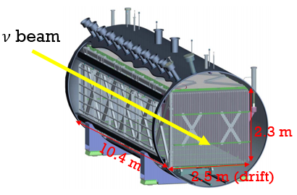
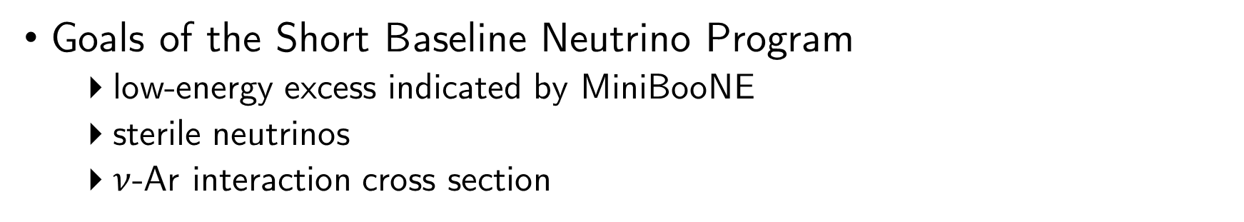
The MicroBooNE Experiment
Low-energy excess observed by MiniBooNE
Goals of the Short Baseline Neutrino Program
low-energy excess indicated by MiniBooNE
sterile neutrinos
$ν$-Ar interaction cross section

Slide 3
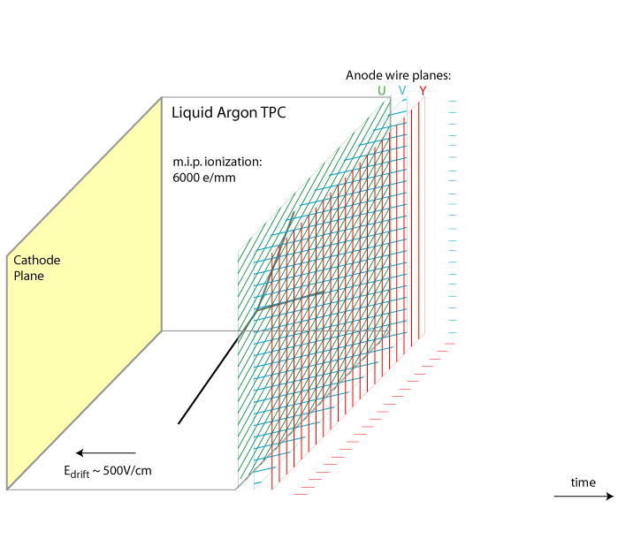
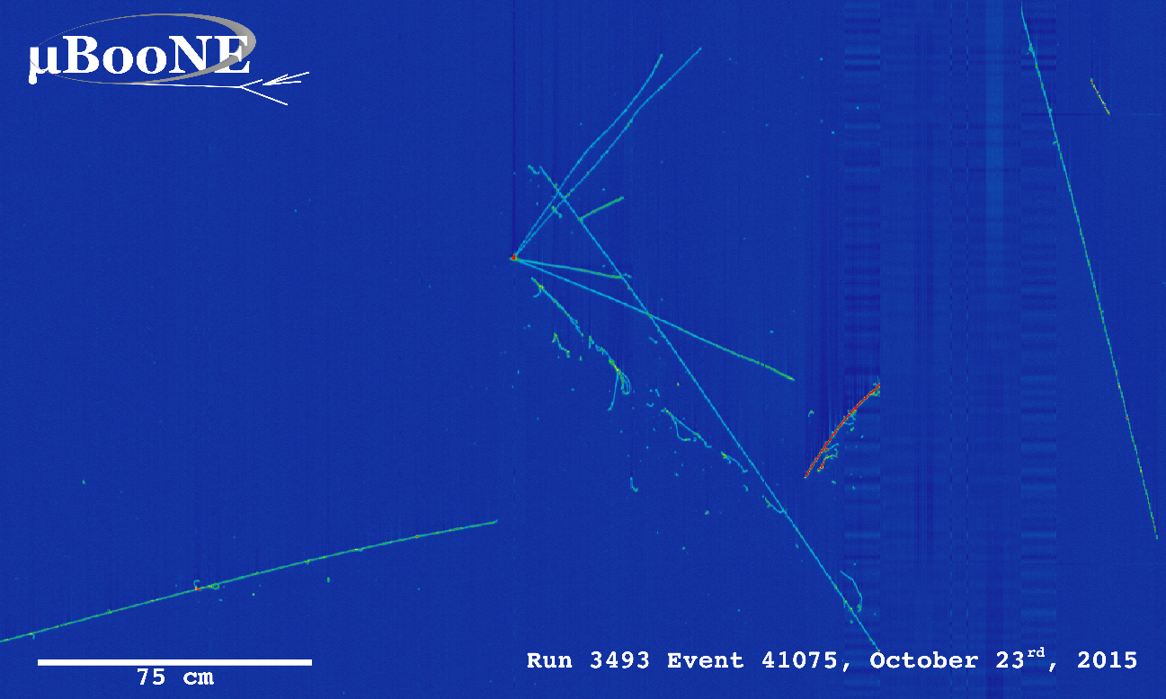
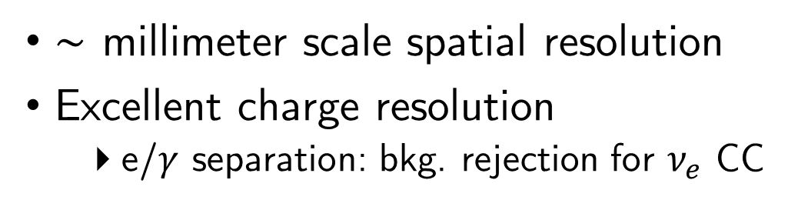
Principle of Single-Phase LArTPC
Made by Bo Yu (BNL)
$\sim$ millimeter scale spatial resolution
Excellent charge resolution
e/$γ$ separation: bkg. rejection for $ν_{e}$ CC
time
Drift velocity ~ O(1) km/s $⇒$ a few ms drift time

Slide 4
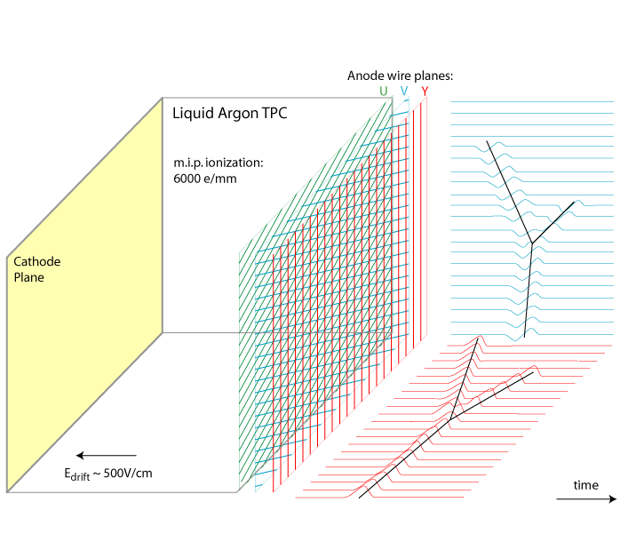
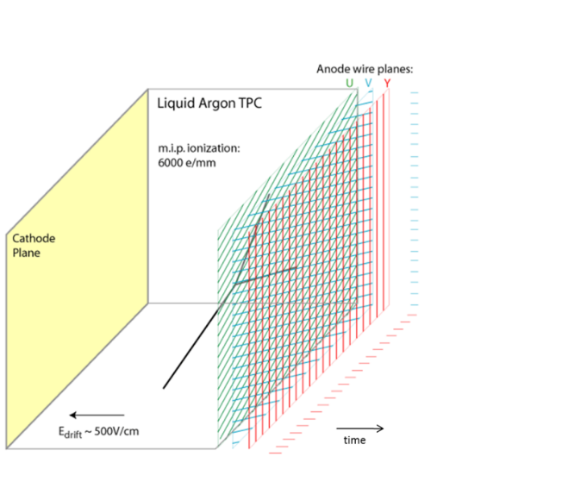
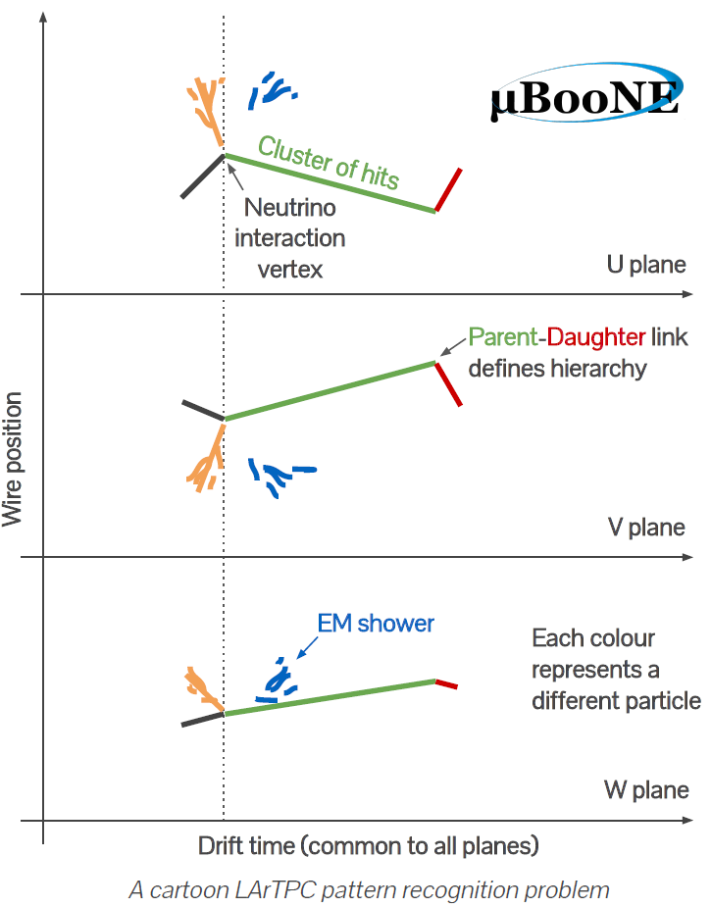
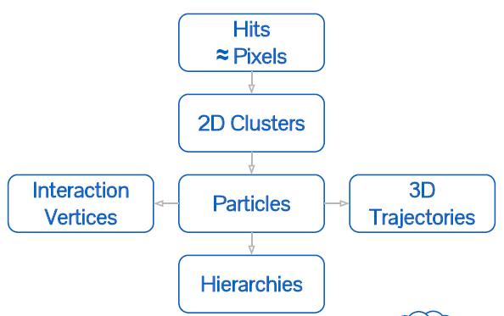

Traditional Reco. Approach: 2D matching $⇒$ 3D
By Andrew Smith
@ 2019 APS April
Illustration of LArTPC pattern recognition in the Pandora framework
Notes:
Systematic uncertainty in pattern recognition will propagate to the later reconstruction steps

Slide 5
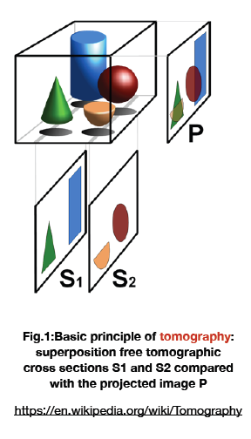
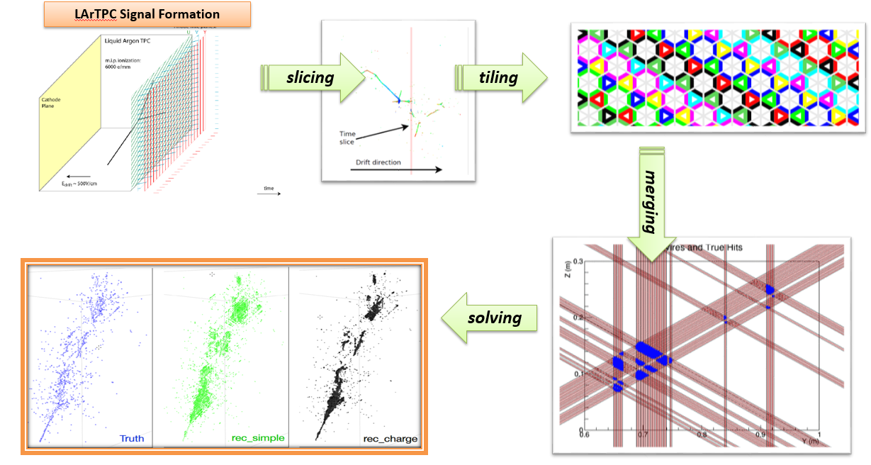
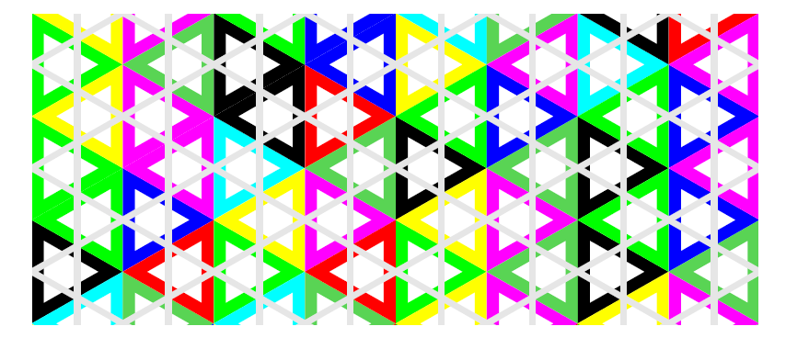
Wire-Cell Tomographic Event Reconstruction
Three-dimensional Imaging for Large LArTPCs
Xin Qian et al. JINST 13, P05032 (2018)

Slide 6
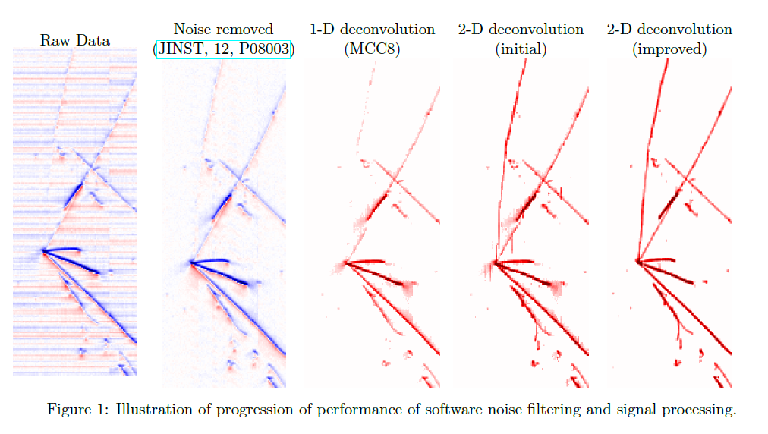
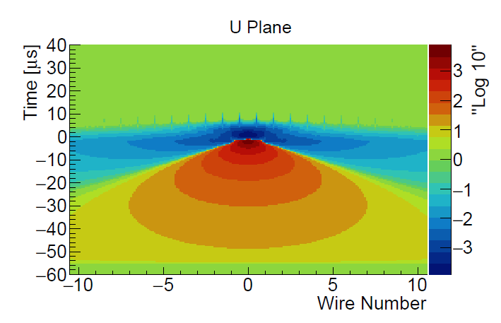
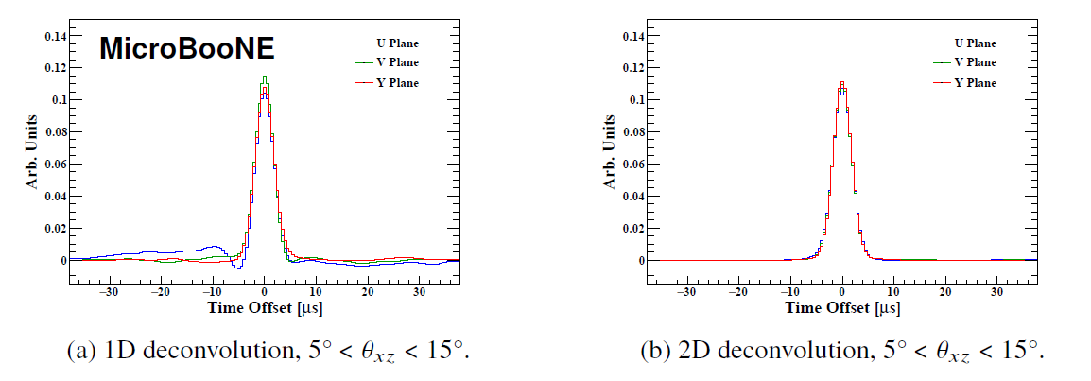
Improved Signal Processing for Tomography
Drift Time
1-D deconvolution
2-D deconvolution
Wire number
JINST 13 P07006/7 (2018)
Key for tomographic imaging

Slide 7
Tomographic Reconstruction: Slicing and Tiling
Tomography scan
2-plane tiling: at least two planes to be “fired” in a time slice

Slide 8
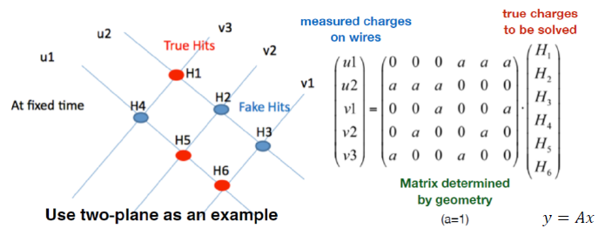
Eliminate Fake Hits: Charge Solving
Fake hits cannot be avoided when tiling the hit cells
Instead, eliminated by solving a linear system with the wire geometry
However, this particular example, 6 unknowns with 5 equations. What to do??

Slide 9
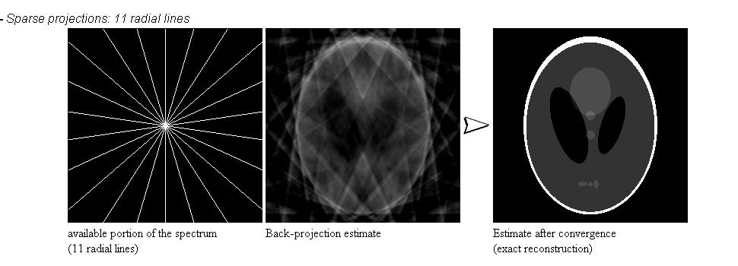
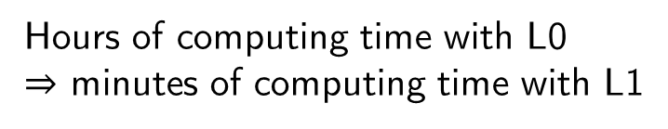
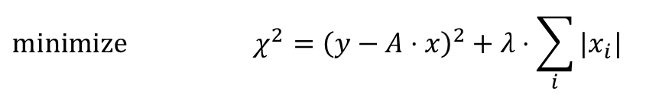
Compressed Sensing
Compressed sensing is a mathematical technique to recover sparse signal from under-determined (linear) system
However, very expensive in computing for a brute force solution
A breakthrough comes from the proof that L0 problem can be well approximated by the L1 regularization
$$\text{minimize} χ^{2}={\left(y−A⋅x\right)}^{2}+λ⋅\sum_{i}{|x_{i}|}$$
Hours of computing time with L0
$⇒$ minutes of computing time with L1

Slide 10
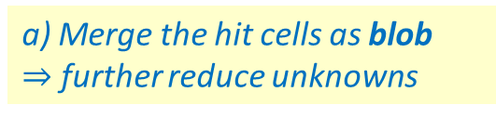
Tomographic Reconstruction: Charge Solving
b) Charge solving w/ L1 regularization
Clearer vertex
a) Merge the hit cells as blob
$⇒$ further reduce unknowns

Slide 11
Deghosting
10% nonfunctional channels add ambiguity
Detach blobs mainly present in the nonfunctional region
Tiling
Before deghosting
After deghosting
Solving
Non-func. region
Deghosting

Slide 12
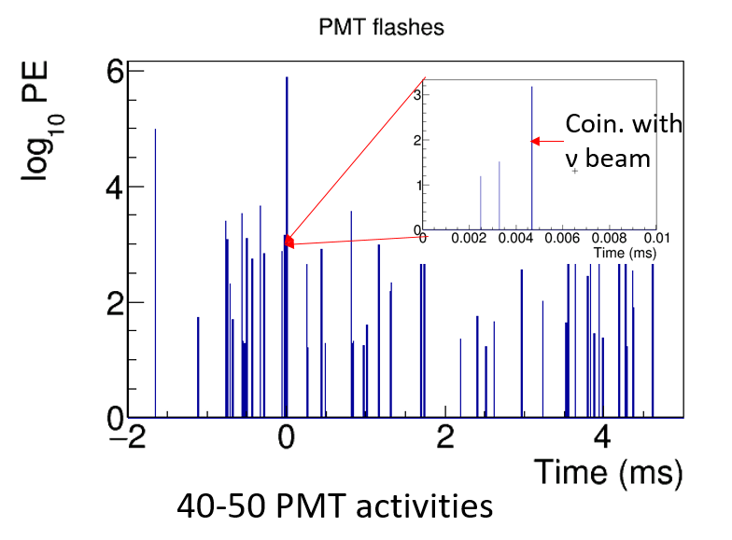
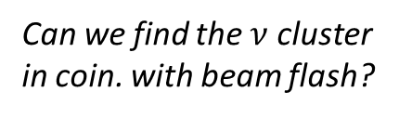

Clustering and “in-beam” flash matching
20-30 clusters / event
40-50 PMT flashes / event
Can we find the $ν$ cluster in coin. with beam flash?
$$⇔$$
Further clustering based on blob distance and directionality
gap bridging
primary track separation: PCA, Kalman-filter, etc.
PMT flash: key for calibrating T0
One cluster matches at most 1 flash
One flash can match any # of cluster (0,1,2, …)
Under-determined system
compressed sensing again!

Slide 13
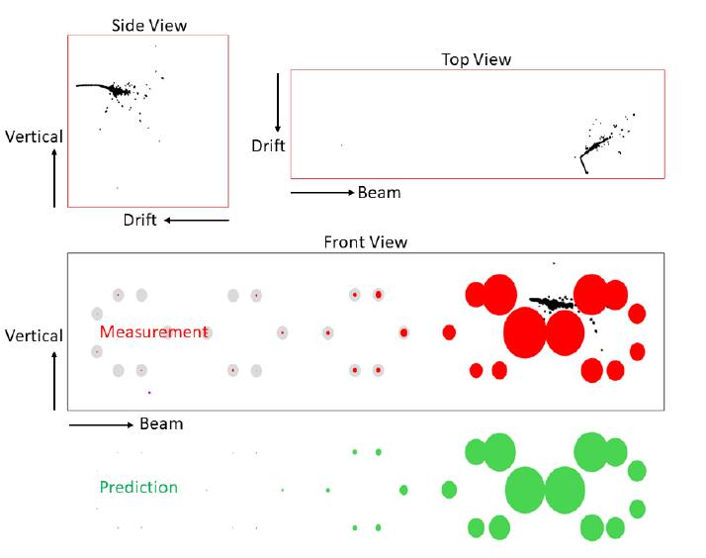
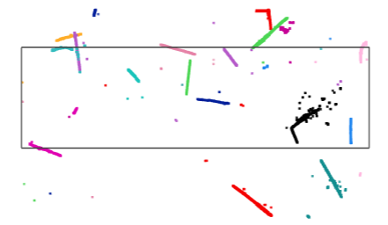
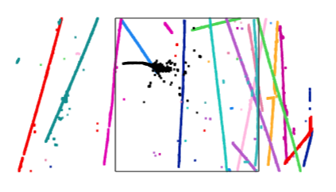
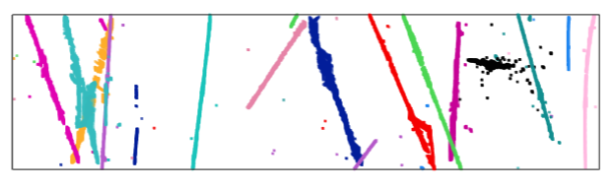
Before and After Flash Matching
Side view
Top view
Front view
Flash Observation
Prediction
CC ν_{e} candidate
MICROBOONE-NOTE-1040-PUB
Over 98% matching accuracy evaluated with cosmic muons

Slide 14
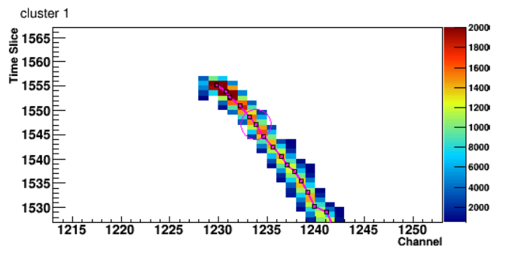
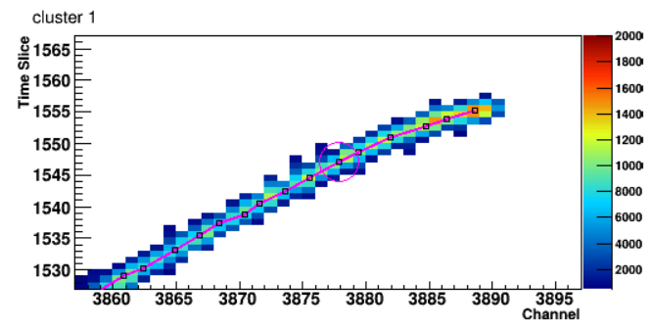
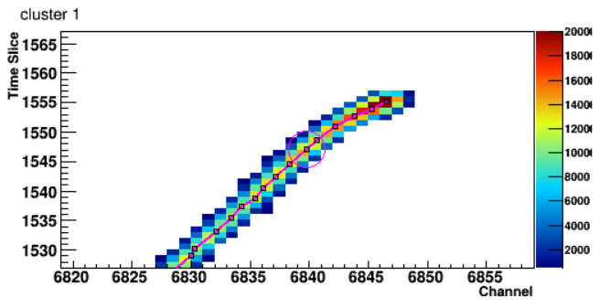
Trajectory Fitting and Particle Identification
MC
Data
In Progress
U view
V view
Y view
Fine trajectory and dE/dx fitting
tomographic clusters as skeleton
Trajectory and charge info matched to three views
2D projection from 3D track hypothesis

Slide 15
Summary
MicroBooNE is a LArTPC capable of imaging neutrino interactions with very fine resolution
broad scope of physics topics – look out for the other MicroBooNE talks!
Wire-Cell tomographic reconstruction is a new paradigm for LArTPC
topology-agnostic 3D space points by utilizing geometry, time, charge and sparseness to reduce ambiguity from individual 2D views
Trajectory and calorimetry reconstruction is in good progress
particle identification
particle flow
…

Slide 16
Backup Slides

Slide 17
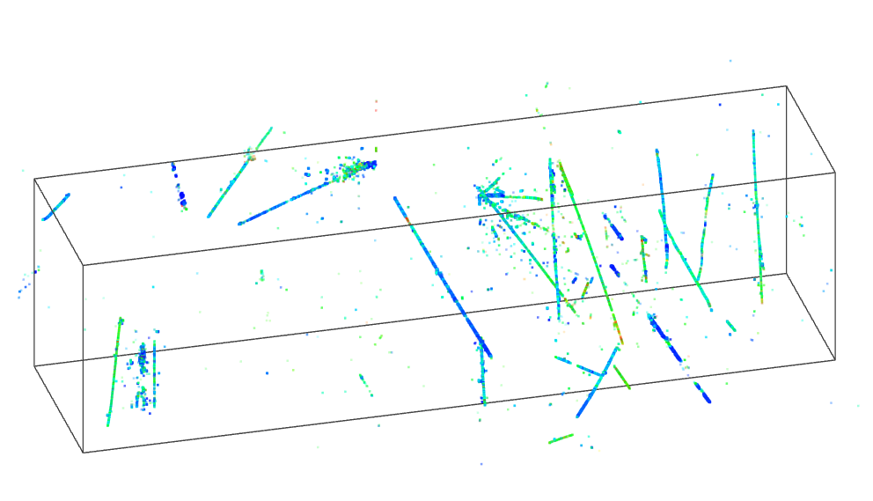
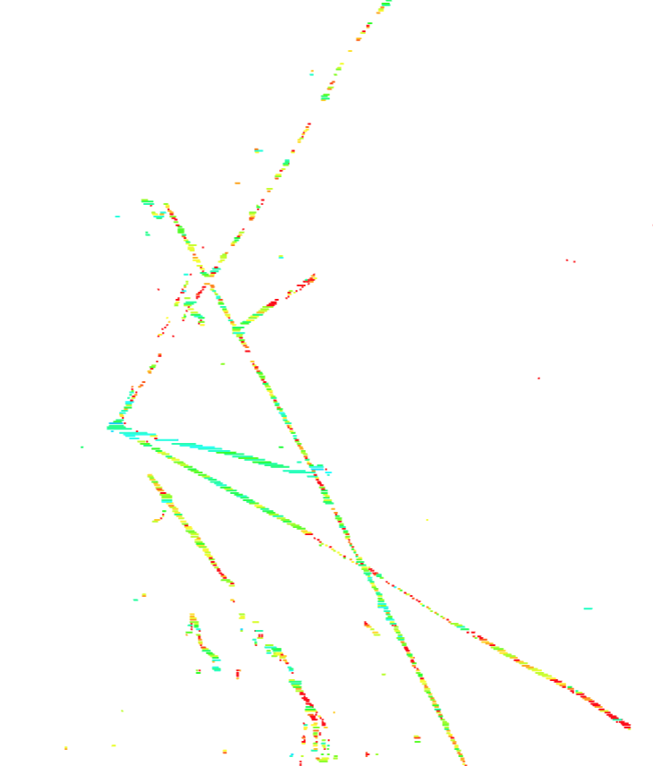
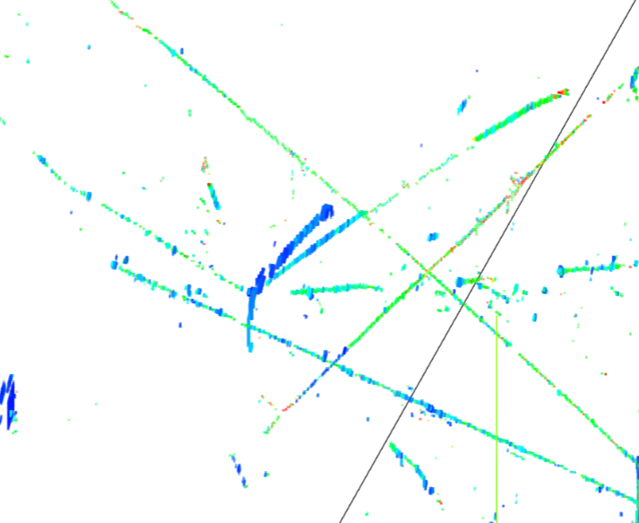
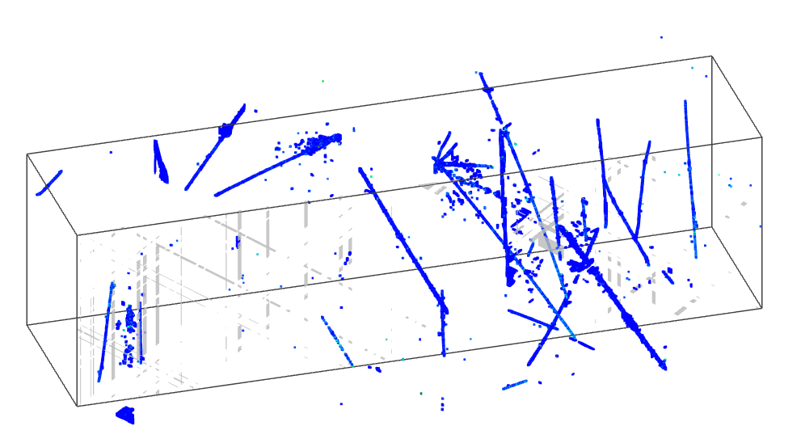
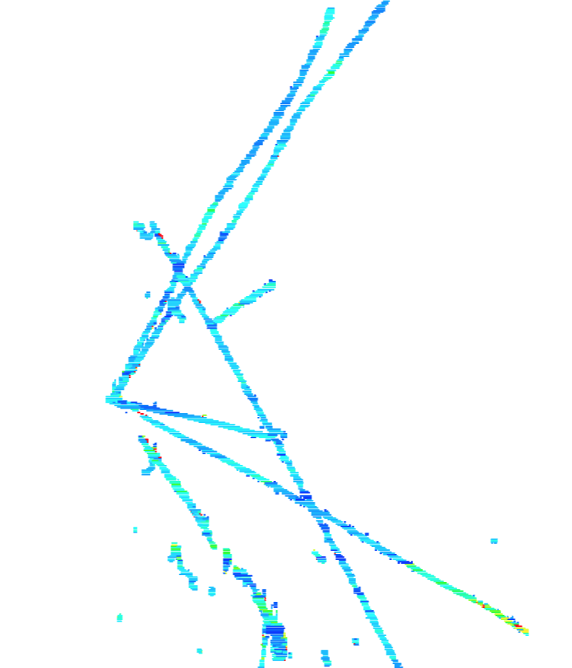
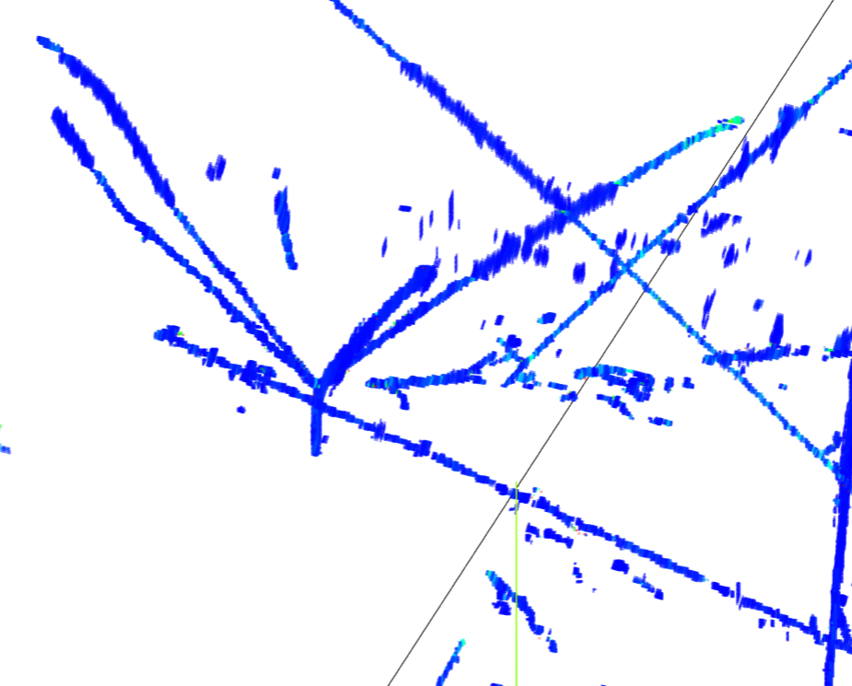
several hours of CPU running
Bee link
(upper) 1D deconvolution + L0 compressed sensing
3 mins of CPU running
Bee link
(lower) 2D deconvolution + L1 regularization
JINST 13, P05032 (2018)
Notes:
Significant improvement in SP and … write something … why is better ??? Remove last line, more dots → more hits, high efficiency …

Slide 18
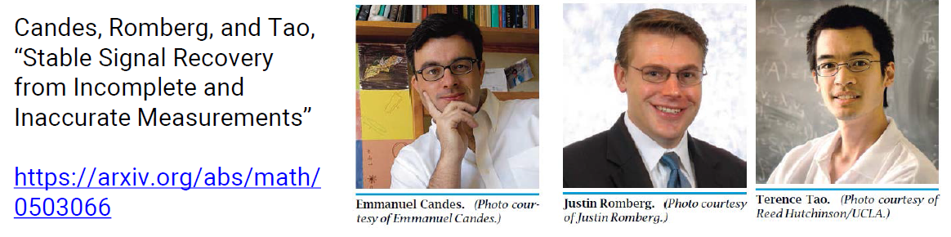
Compressed Sensing
Compressed sensing is a mathematical technique to recover sparse signal from under-determined (linear) system
Example: Tomography with few projections:
Here ||x||₀ is the L0-norm of x, which counts the number of non-zero entries in x
Find the sparsest solution approaching the true signal
Allow one to reconstruct the image with far less projections
Direct application to LArTPC problem

Slide 19
2D Deconvolution
Measured waveform
1-D deconvolution
2-D deconvolution
R₁ represents the induced signal from (i+1)th wire signal to ith wire
The inversion of matrix R can again be done with deconvolution → 2-D Fast Fourier Transformation
JINST 13 P07006/7 (2018)

Slide 20
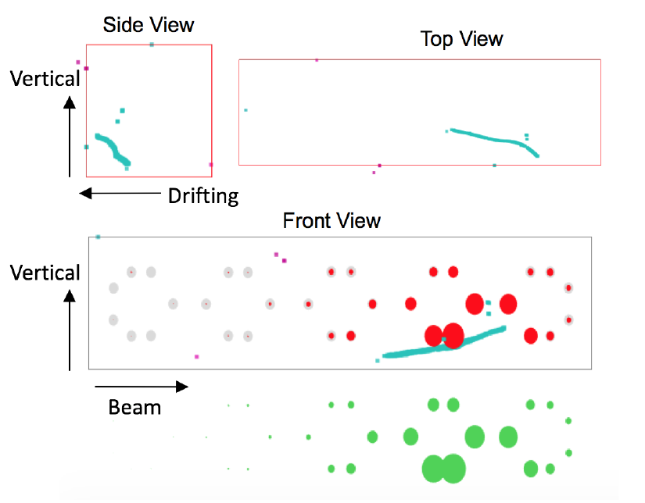
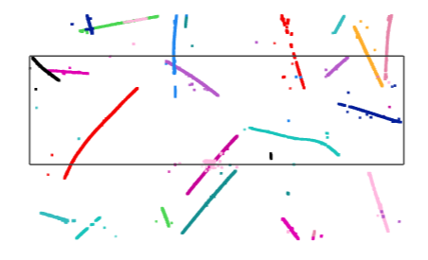
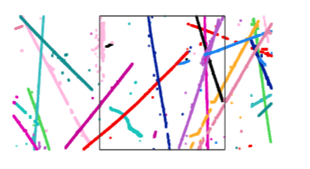
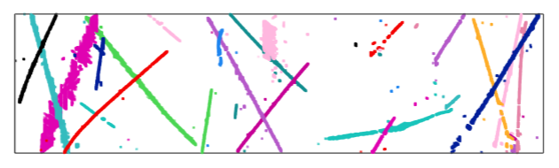
Before and After L1 Matching
Side view
Top view
Front view
Flash Observation
Prediction
Charged-Current ν_{μ} candidate
More details in MICROBOONE-NOTE-1040-PUB

